Slide 1
The Slide Deck
Skills4EOSC T2.3

Slide 2
Instructor Led Learning
Augment the learner’s notebook with a slide deck
Options
Power Point open pptx
recommended for visually appealing presentations
towards rich learning experience
Quarto qmd (or similar) + rendering
to provide clean, simple slides
improved reusability

Slide 3
Power Point Slides
design elements are attractive and draw attention
alignment
colour palette
charts and graphs
fonts
animations
transitions
…
export to PDF for learners
1-6-6 rule
1 topic per slide
6 bullets per topic
6 words per bullet
Guy Kawasaki’s 10 slides /20 mins /30 pts rule
80-20 rule
80% of your time = visuals
20% of your time = words

Slide 4
Quarto presentation
Quarto = open-source scientific and technical publishing system
write using markdown
Variety of formats for creating presentations:
reveal.js (HTML)
PowerPoint (MS Office)
Beamer (LaTeX/PDF)

Slide 5
Setting up Quarto
Install Quarto from the Get Started page
Setup Obsidian to be able to create Quarto presentations (.qmd files)
add the qmd as md community plugin
use the template_quarto.qmd
run Quarto to render to pptx

Slide 6
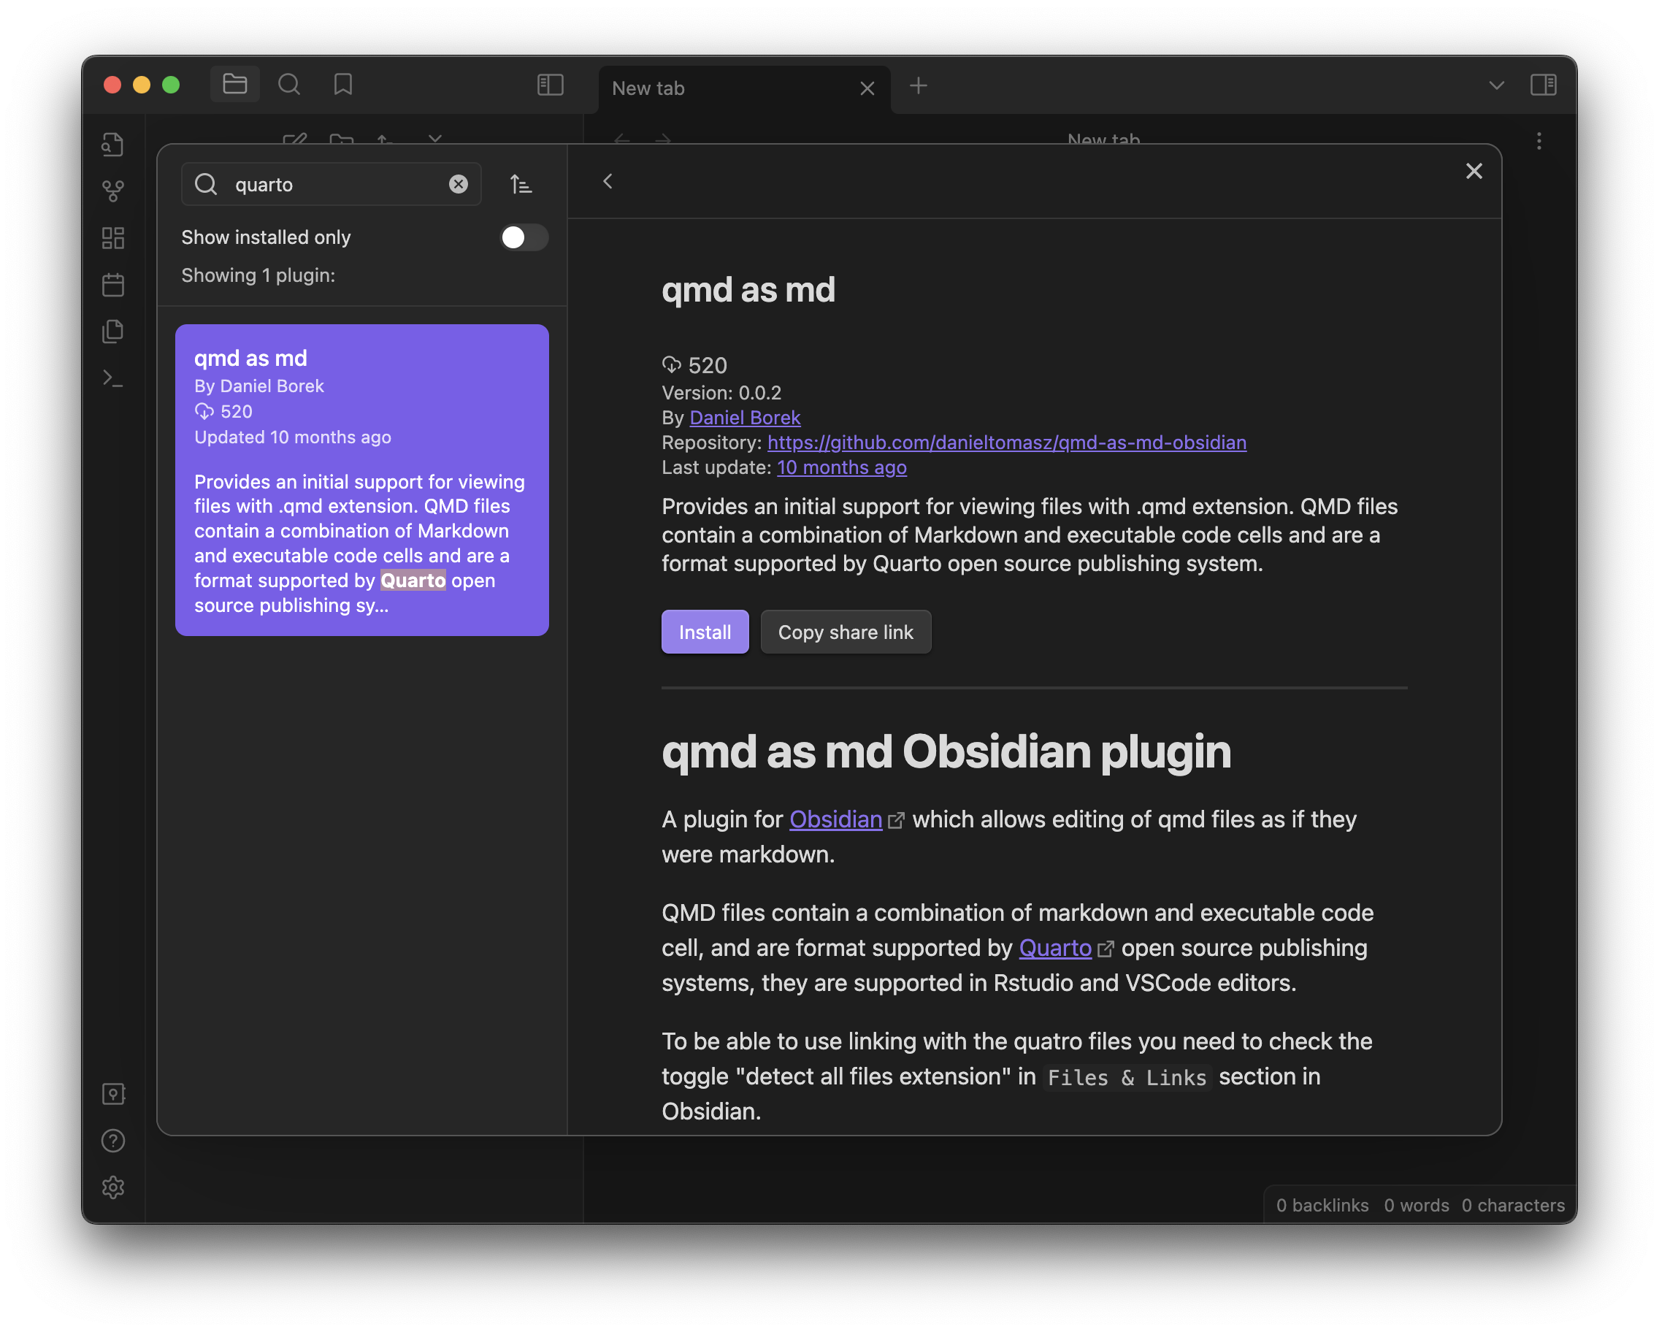
QMD as MD community plugin
Settings -> Community Plugins
Turn on community plugins
search for quarto
install qmd as md
enable
qmd as md plugin in Obsidian

Slide 7
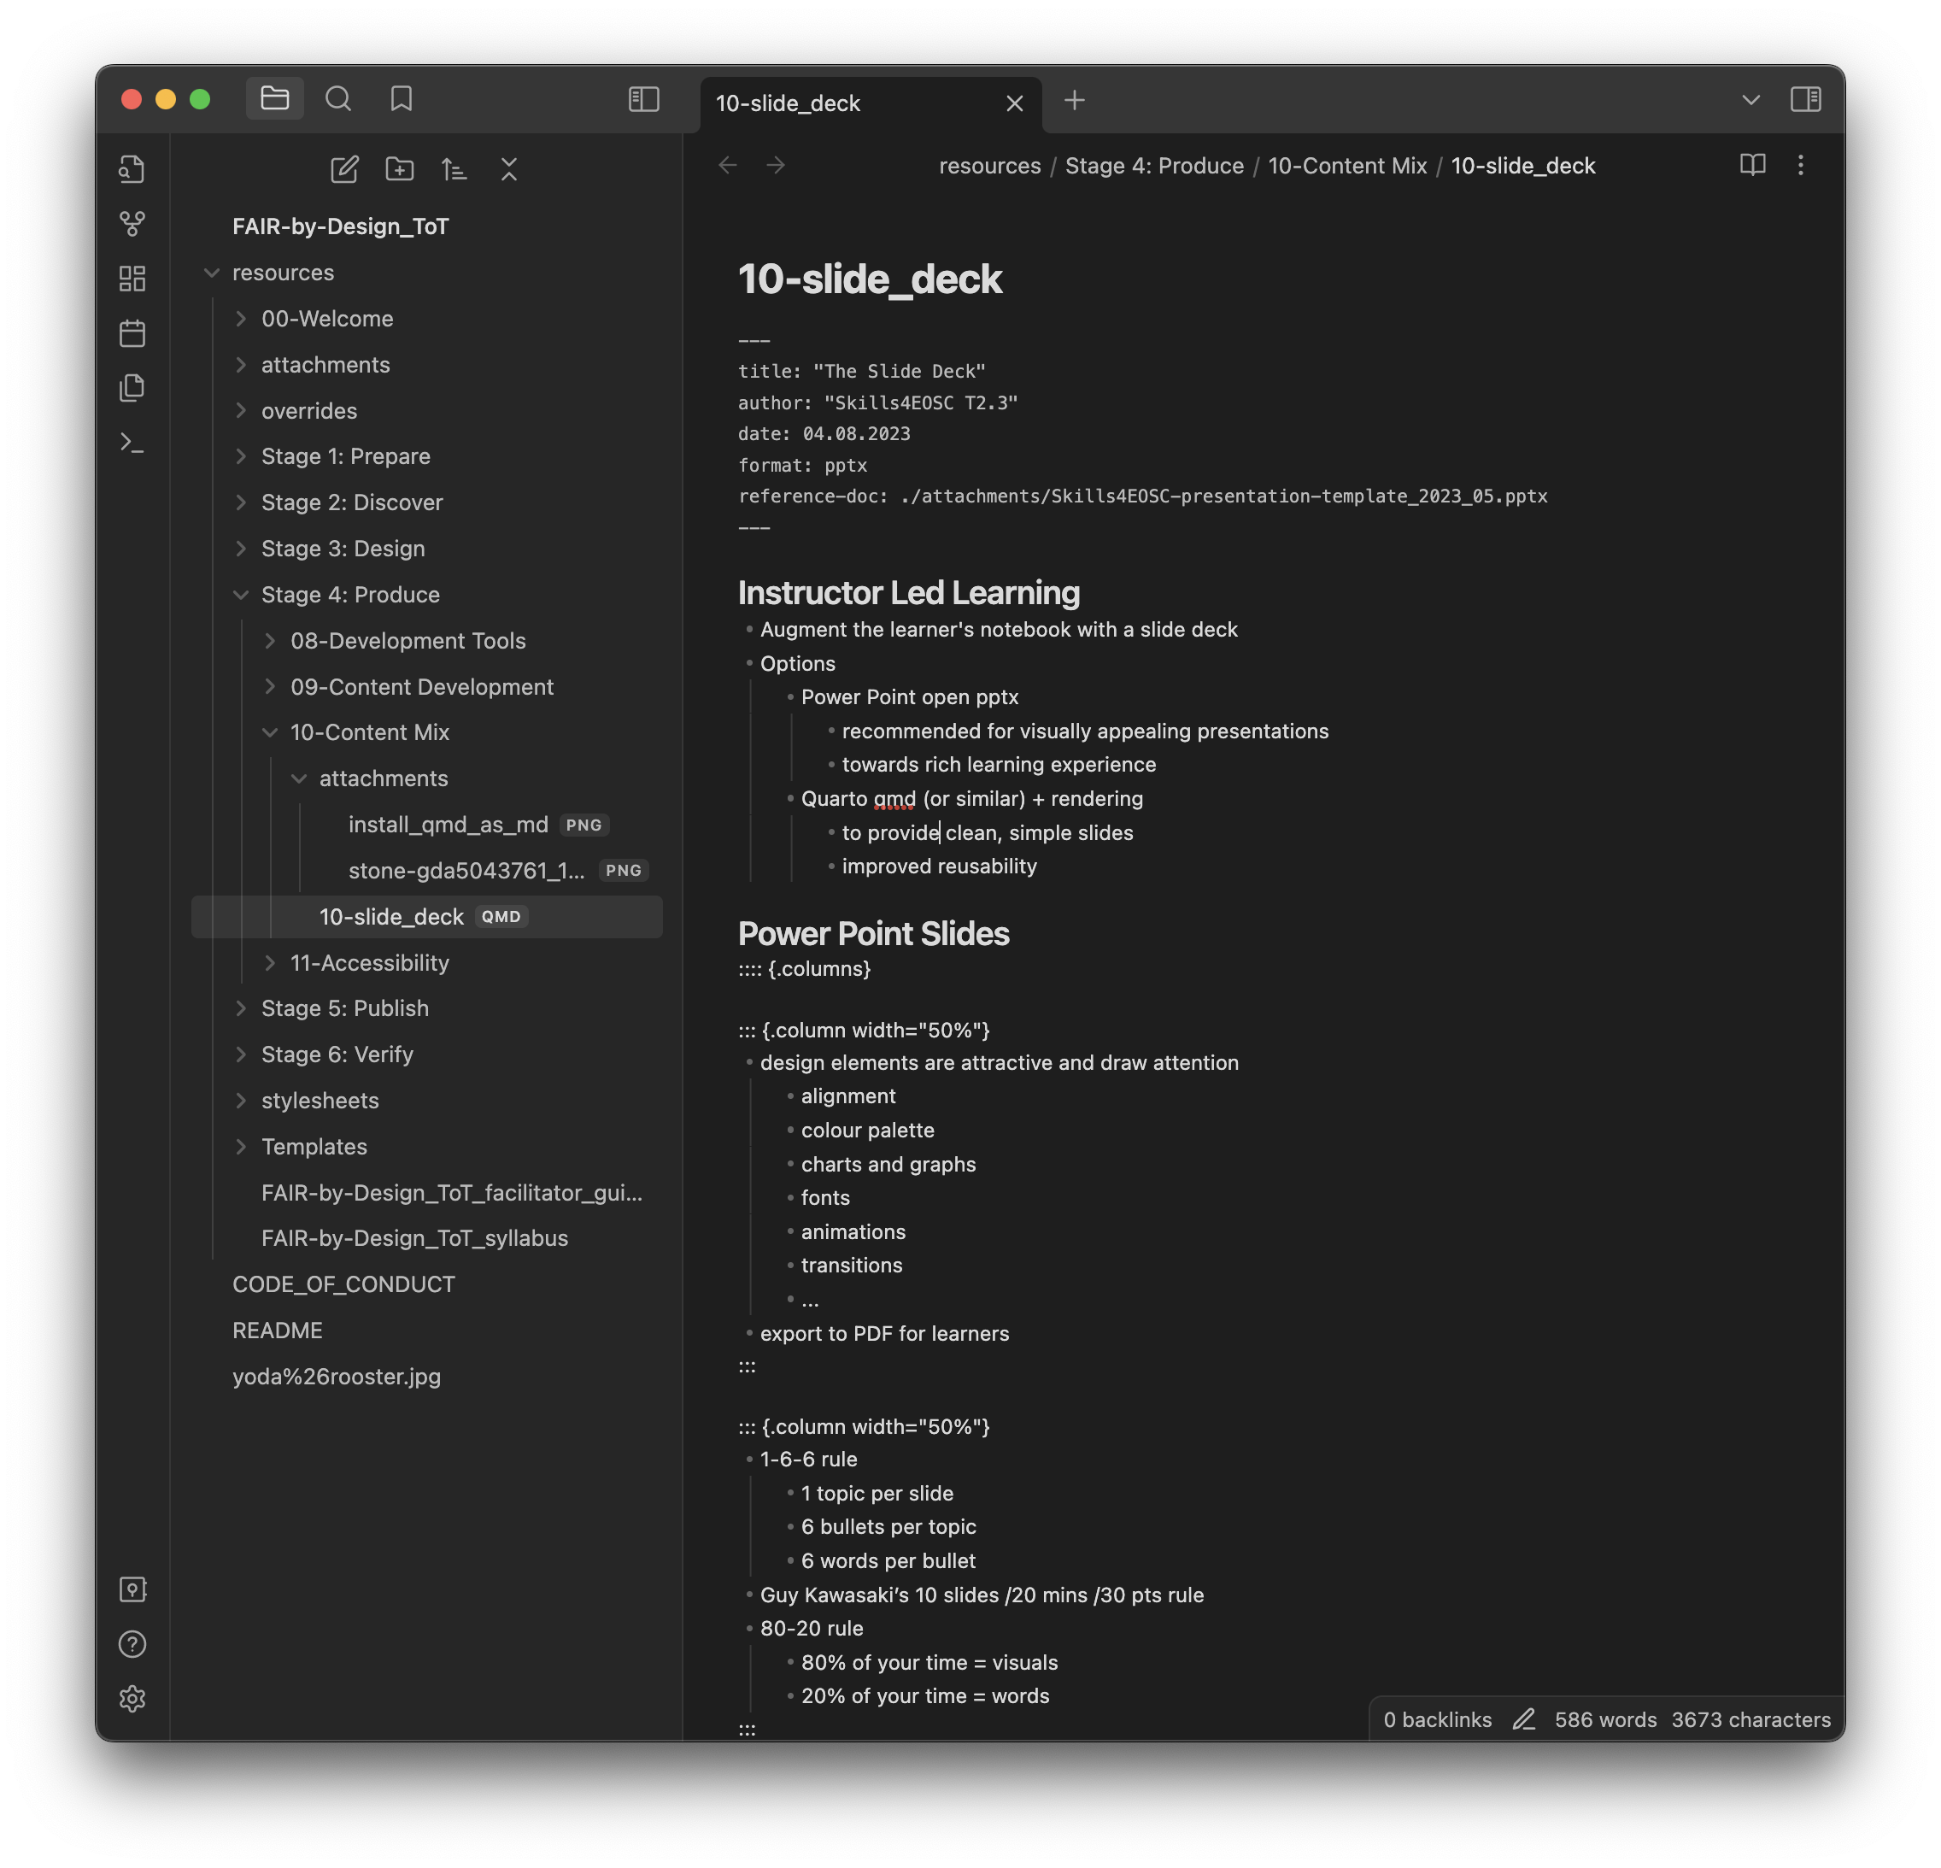
The QMD file
enhanced markdown
examples for basic layouts and options are provided in the template file
example content of a qmd file

Slide 8
Header
the information from the header is used for the title slide
title
author
date
format: pptx
used to render to Power Point file
reference-doc: template_file.pptx
the Power Point template that should be used
note: it only recognises the basic slide layout

Slide 9
Basic slides
use heading 1 (#) for section title slides
normal slide title is heading 2 (##)
use (-) for an unnumbered bullet list
or (1, 2, ..) for a numbered bullet list
tables and images are referenced as in regular MD
image alt text is used as image caption (use for attribution text)

Slide 10
Slide with speaker notes
Notes should be provided between a specific set of commands that start with 3 columns ::: as presented here
::: {.notes}
Speaker notes go here.
:::
Notes:
Speaker notes go here.

Slide 11

Slide with columns
are defined between
:::: {.columns}
and
::::
each column content should be between
::: {.column width=“40%”}
and
:::
content can be image, table, text, bullets
Image by Elias from Pixabay

Slide 12
Run Quarto
open terminal
navigate to the location of the qmd file
run
quarto render FILENAME.qmd
the pptx file will be generated in the same location

Slide 13
Summary
a slide deck is an optional additional learning content
used in instructor led environment
should enrich the learning experience
use an open file format such as
pptx
qmd
or similar

